Slide 1
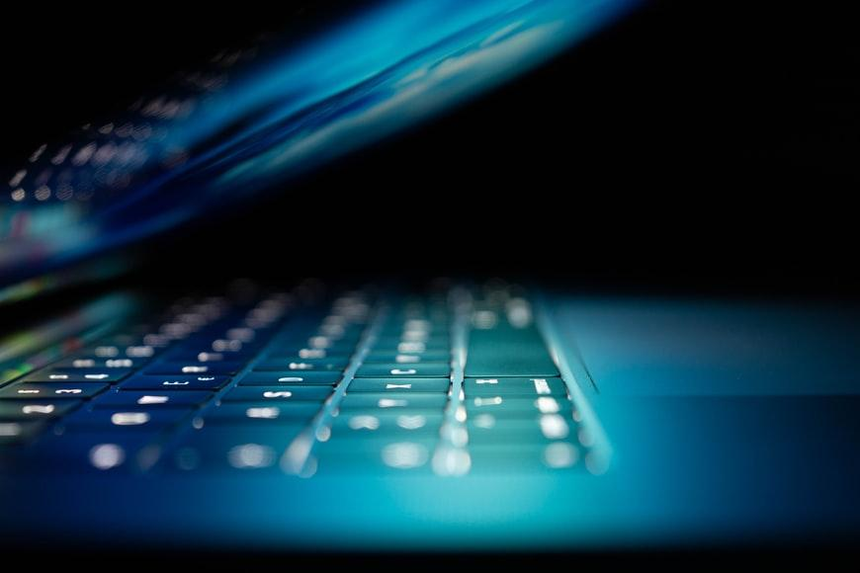






Device Security
Cyber Forensics
CCTV
Secure Payment
Computer Security
Fingerprint
Global Security
Presented by Akram and Mushahid

Slide 2
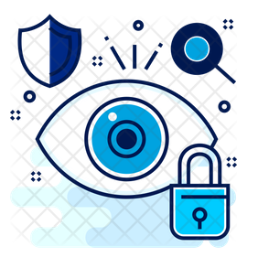
Cyber Security
What? Cybersecurity tends to focus on how malicious actors use electronic assets
(Internet, WAN, LAN, routers, printers, network appliances) to attack information.
Why? To prevent individuals, organizations, financial institutions and universities from cyber attacks including, ransomware, malware etc.
How? Running the assets safely with security implementations of databases, networks, hardware, firewalls and encryption.
Cyber Forensics
?

Slide 3
Cyber Forensics
What? The practice of gathering, retaining, and analyzing computer-related data for investigative purposes in a manner that maintains the integrity of the data.
How? Through the digital forensics investigation process including: Identification, Preservation, Analysis, and Presentation (IPAP).
Why? Used in criminal investigations to identify what happened, how it happened, when it happened and the people involved.
?
Cyber Forensics

Slide 4
Cyber Security and Cyber Forensics Relationship
Cybersecurity aims to protect electronic assets from breaches.
Cyber forensics explains how a policy became violated and who was responsible for it
Cyber Forensics
Cyber Security
Cyber Forensics
Fig. 1 Feedback cycle of Cybersecurity and Cyber Forensics

Slide 5
Cyber Forensics Guidelines
Don’t Touch the Suspect Drive
Evidence may vanish
Document Trail
Document the crime evidence
Secure the Evidence
Make computer offline
Limit Access
Document Person who has access
Document Losses
Cause high cost
Finding Evidence in the Browser
Search history
Cyber stalking
Cyber Forensics

Slide 6
Digital Forensics Investigation Process Mode
Examination
.
Analysis
.
Presentation
.
Cyber Forensics
.
Collection
.
Preservation
.
Identification
At Crime Scene
At Lab

Slide 7




Cyber Forensics: Tools
Windows Event Viewer
Magnet Forensics
MALTEGO
Disk Digger
Autopsy
ENCase
Cyber Forensics

Slide 8
Thank You!

